Slide 1

TRIPSPHERE
Objective:
To design and develop a dynamic, cloud-deployed travel planning web application using the ASP.NET Core MVC framework that enables users to create, manage, and review travel plans with integrated feedback and contact features, ensuring a seamless and responsive user experience.
Team members:
Ankita Tripathy
Namratha Vardhineni
Subham Mohanty
Vaishnavi Chitumalla

Slide 2
Meet the team
Ankita Tripathy
UI/UX Designer& Front-End Developer
Ankita, with 10+ years of experience in financial sector, transformed static designs into a responsive web app. She built the Homepage, Analytics Dashboard and implemented complete CRUD operations using MVC,CSS Grid,Flexbox and Weather API integration.
Namratha Vardhineni
Developer & Data Analyst
Namratha, a data Analyst with 4+ years of experience at Capgemini, specializes in workflow automation and clinical data analysis. She developed the Book Now and Contact Us APIs, handled SQL Server integration via entity Framework core and ensured secure backend functionality.
Subham Mohanty
Authentication & UX Flow Architect
Subham with 3 years of experience at wipro in SAP and predictive modeling,built secure login/signup flows using JWT and ASP.NET Core identity. He also developed feedback features and ensured role-based authorization and secure cloud data handling.
Vaishnavi Chitumalla
GitHub & Documentation Manager
Vaishnavi, with 2.5 years experience in cloud at Atos, managed version control and CI/CD via GitHub Actions. She handled Azure deployment, set up SQL integration and led the project documentation and presentation design.

Slide 3
Technical overview
Goal
Provide an intuitive web platform for trip planning, with features like integrated feedback forms and contact support to enhance the user experience
Architecture
Technical Focus
The application implements full CRUD operations for managing travel plans and feedback submissions. It establishes clear foreign key relationships, linking travel plans to their corresponding travelling modes and feedback entries to specific trips the system is deployed on azure ensuring live access with seamless SQL database integration. The front end is built using razor pages & styled with bootstrap to ensure user friendly experience across devices.
The application follows ASP.NET Core MVC architecture, which separates concerns into models, Views and Controllers. It uses Entity Framework Core to manage SQL- database operations and relationships.

Slide 4
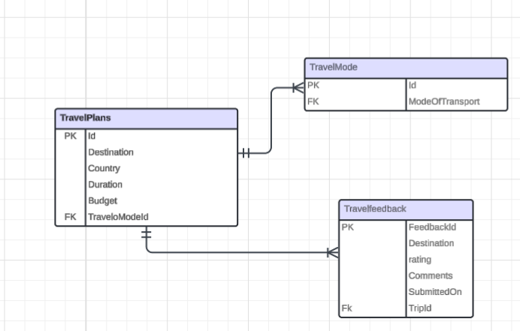
Data Structure of the TripSphere
Table
Primary Function
TravelMode
Stores different types of transport(like Flight, Train, Bus) used in travel plans.
TravelPlans
Holds trip details such as destination, duration, budget and linked travel mode.
TravelFeedback
Stores user ratings and comments for travel plans. Useful for clarity insights.
Users
Stores user account data like username, email and password for login/authentication.
ContactMessages
Captures user inquiries, messages or feedback submitted through the contact form.

Slide 5
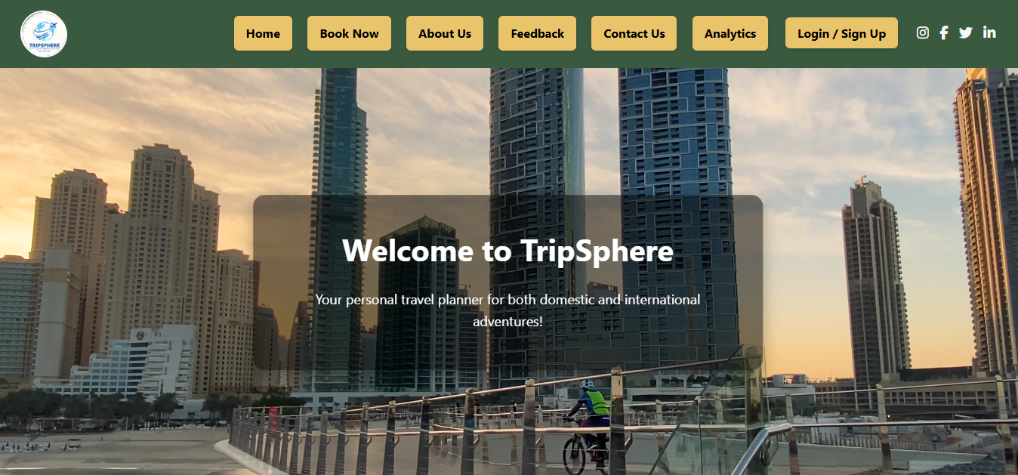
Welcome To TripSphere

Slide 6
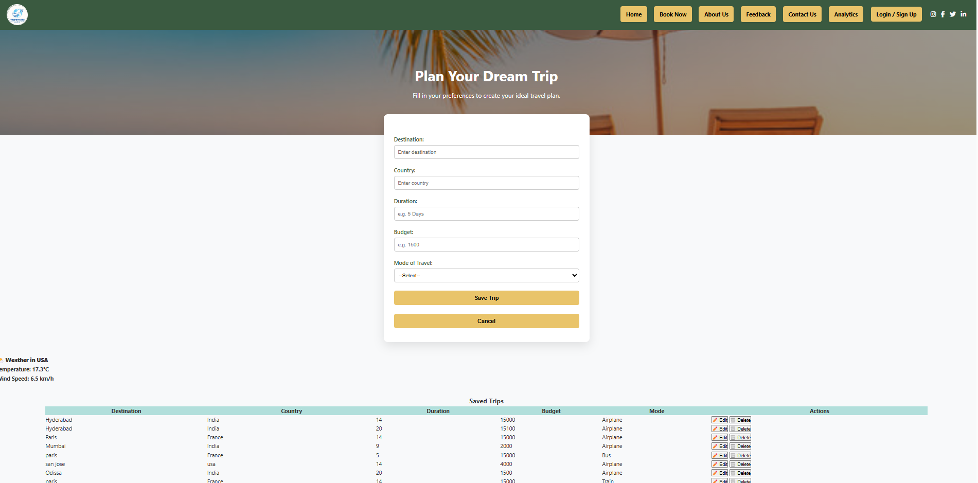
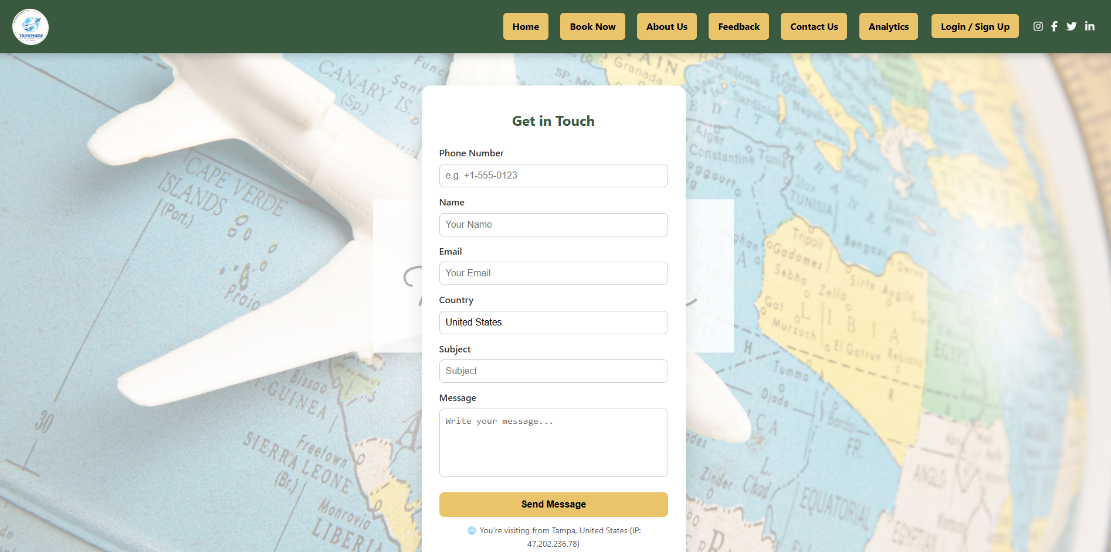
BookNow & ContactUs API’s

Slide 7

Key Learnings and Challenges
.Challenges Faced
Initial issues in integrating backend APIs with frontend forms.
Debugging authentication flow and managing token-based login securely.
Deployment configuration issues on Azure App Service and setting up database connections for production.
Key Learnings
Understood how to build a complete web app using ASP.NET Core MVC with Entity Framework and SQL Server.
Gained hands-on experience in API development, cloud deployment on Azure, and using CI/CD pipelines through GitHub Actions.
Learned team collaboration using Git branching strategies, resolving merge conflicts, and handling real-world project workflows

Slide 8

Thankyou for Your Time!

